Slide 1
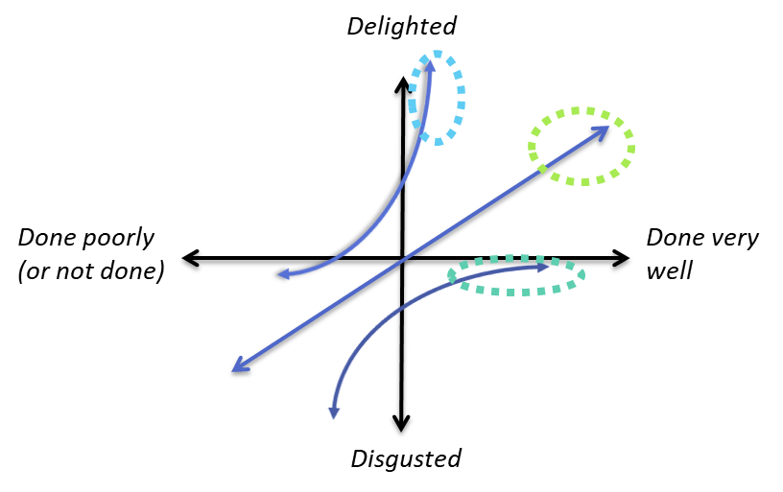
User needs (Kano model)
3
Attractive needs (delighters)
Unspoken, not expected
Need 1
Need 2
Need 3
2
Performance needs
Stated, more is better
Need 1
Need 2
Need 3
1
Basic needs
“Must be” requirements
Need 1
Need 2
Need 3

Slide 2
Kano model Noriaki Kano, 1984
Not all user needs are equal. Customers have different priorities and meanings attached to these needs, and as a product manager, you need to understand this. The Kano model can help.
Focusing on a single customer segment, the Kano model can help separated customer needs into:
Attractive needs
The extra needs that customers don’t articulate, but love when you deliver on them
Airline example: getting upgraded to 1st class
Performance needs
The areas that you typically compete on, like service quality, response time, pricing, etc.
Airline example: seat comfort, movie selection, quality of snacks, etc.
Basic needs
What you must do – these are table stakes to play in this market
Airline example: getting your checked luggage to your destination
3
2
1

